Slide 1






Exploratory Data Analysis and implementation of
Machine Learning Algorithm on mobile models’ dataset
Made By
Rishav Bairagya
Sarthak Dutta
Souma Das

Slide 2
OUR TEAM FROM NARULA INSTITUTE OF TECHNOLOGY
Rishav Bairagya
Souma Das
Student at Narula Institute of technology
Student at Narula Institute of technology
Sarthak Dutta
Student at Narula Institute of technology

Slide 3






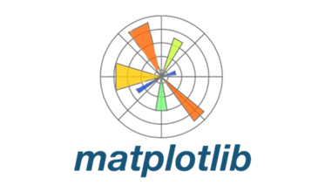

Libraries used
Dataset source from Kaggle
Presentation Title

Slide 4
ABOUT DATASET
Features | Description | type
Brand | Company that manufactured the mobile model | object
Model | The unique ID with which the model is released in market | object
colour | The colour of the mobile model chassis | object
Memory | RAM capacity of that mobile model | object
Storage | Storage capacity of that mobile model | object
Camera | Camera present or not | object
Rating | Customer Feedback in a scale of 5 | Float
Selling Price | Actual price for which the model is sold in market | int
Original Price | MRP assigned to that mobile phone model | Int
Mobile | The Global Model Name of that Mobile | Object
Discount | Discount amount offered by the company on Original Price | int
Our Dataset is based on Mobile Models Data, consisting of Data across 17 Different Brands, 3114 values and 11 features

Slide 5


Data Preprocessing
Data Cleaning
Removing Null Values
Removing Duplicates
Data Encoding
Transforming Categorical data
Making it understandable for machine
Sometimes data should be encoded into meaning values for better insights

Slide 6
DATA ANALYTICS

Slide 7
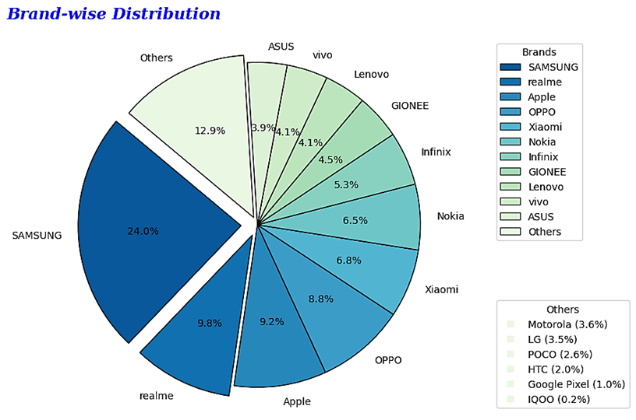
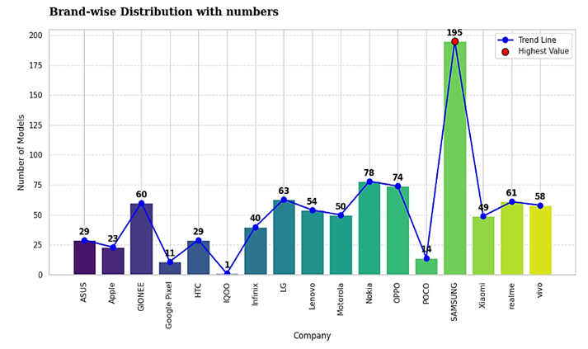
Distribution of Data
We can see Samsung has the most number of models in the dataset.
Hence Samsung is the most popular brand in the dataset.
This signifies that either Samsung
have most number of models releases per year or each model of Samsung has multiple variants.

Slide 8
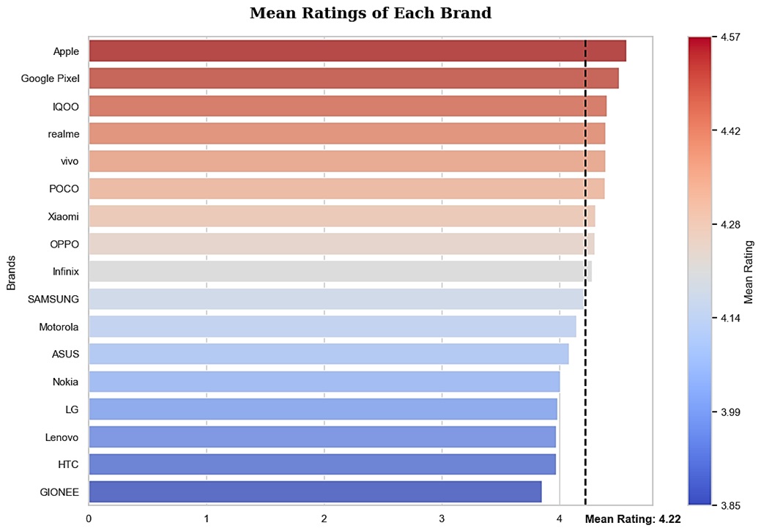
Ratings of each Brand
We can see APPLE is the most rated brand in the dataset. This signifies that apple has the most number of models with higher ratings.
The reasons could be that apple has the best pricing strategy or the best quality of the products, or it is reaping the benefits of the brand name.
We will see this in the upcoming price discount analysis.

Slide 9
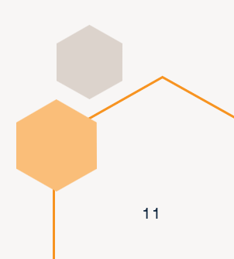
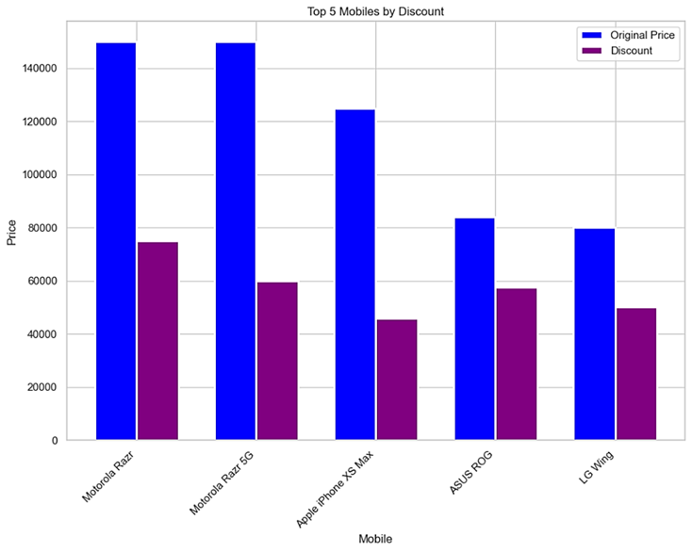
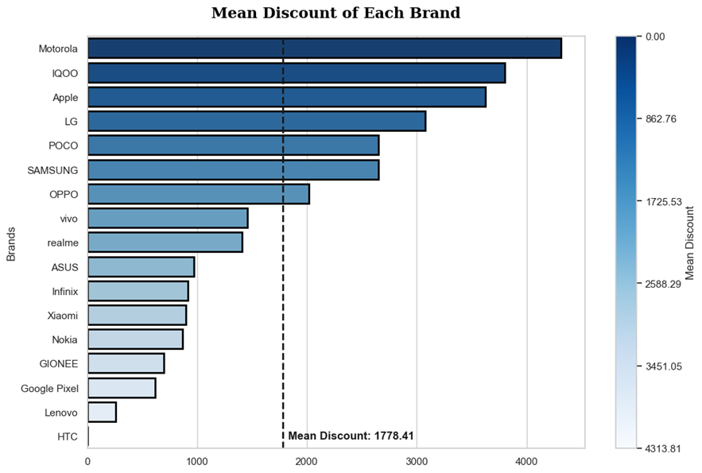
Discounts!! offered
Motorola and LG are among the top 5 position in terms of discount rate but Asus’s mean discount rate is not always the highest.

Slide 10
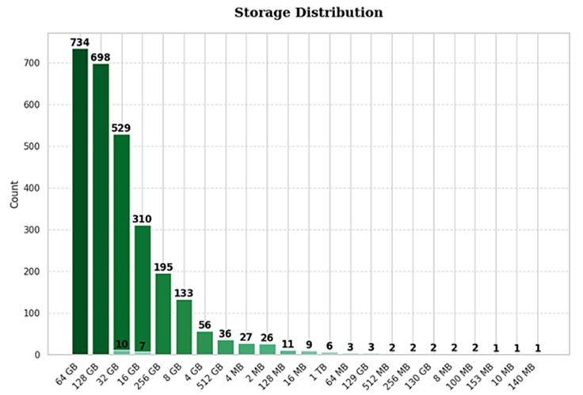
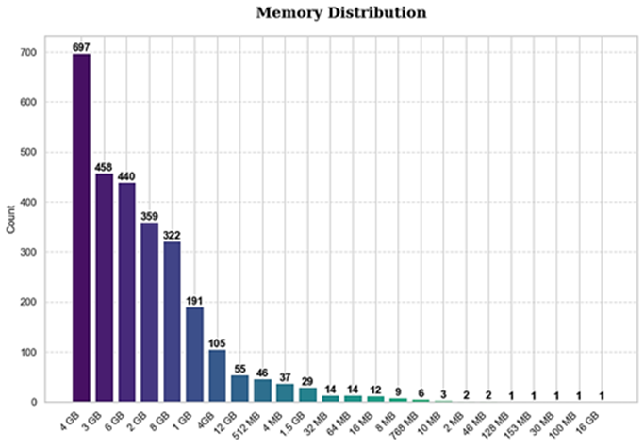
Memory and Storage Distribution
The fact that companies are focusing on more 64GB and 128GB models is very good, which shows how demands are increasing for more storage
By far the most popular memory size is 4GB, which is obvious as most of the phones are in the mid range category. There is one 16 GB model which means companies do not target the gaming industry much

Slide 11
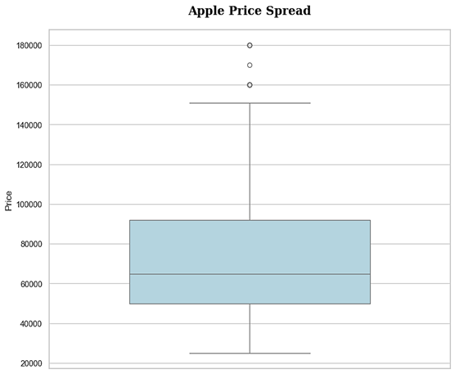
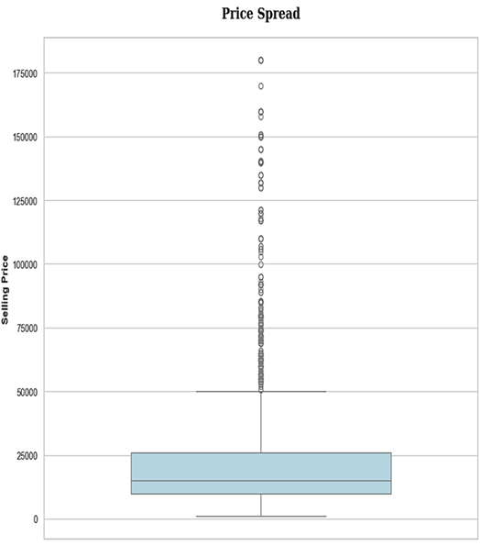
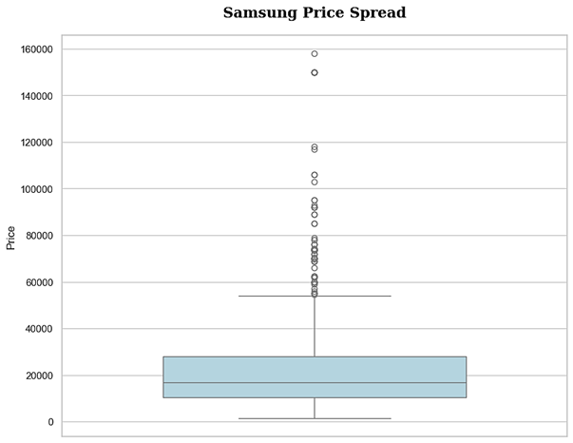
Price Spread
We can see most of the data is clustered in the budget phones range.
The outliers cannot be also removed since we can see luxury brands like Apple lie solely in the range of 50000 and above.
Samsung on the other hand is spread throughout

Slide 12
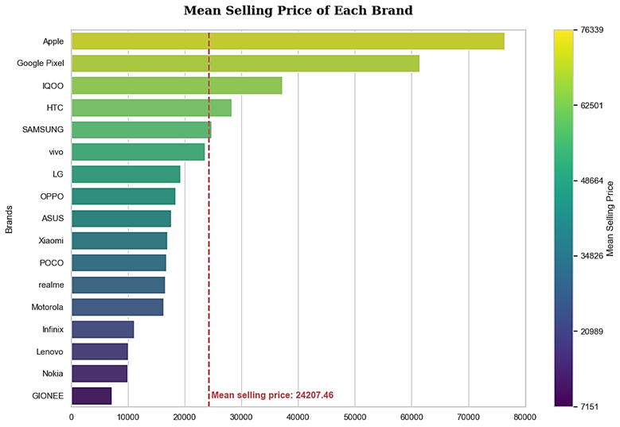
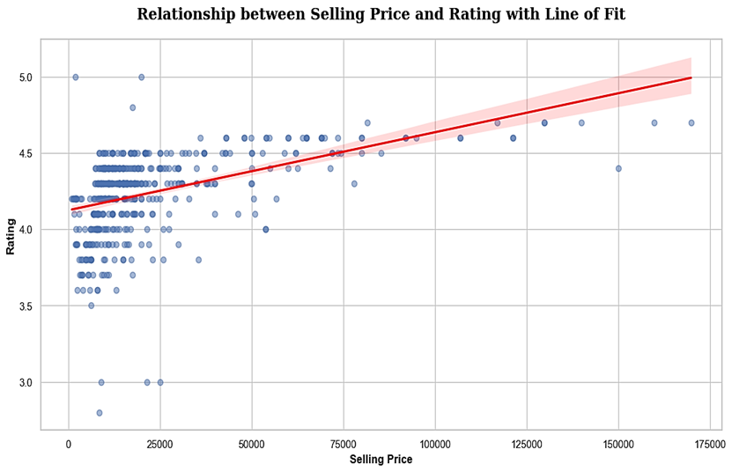
Price Spread
We can see in terms of selling price Motorola is very low in the list making it very consumer friendly, along with gionee and nokia
Although Gionee, Nokia, Lenovo have the least selling price, their ratings are also lower compared to other brands.
On contrary to this, Apple has the highest selling price but also has the highest ratings. Hence indeed Apple reaps the benefit of being a luxury brand.
Also from price vs rating we can see that not many negative reviews in premium category

Slide 13
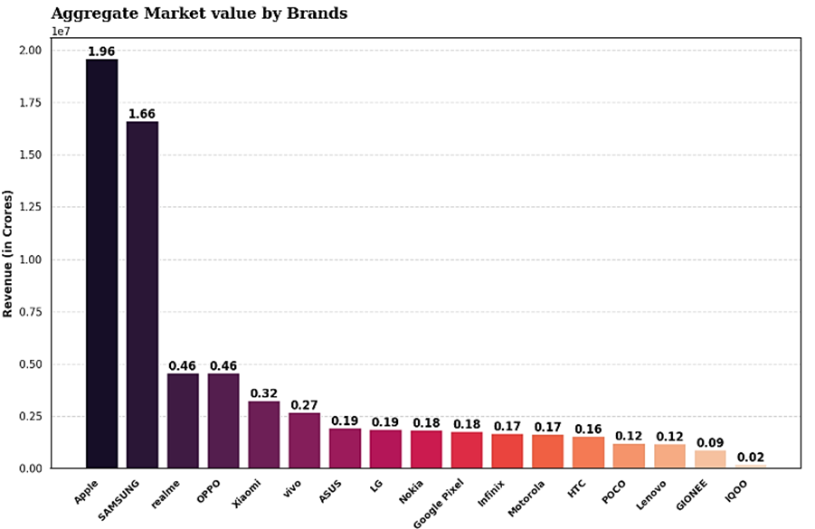
Market value of each brand
This shows that Apple has the largest Market value amongst all other brands and Samsung just falling short by a few margins, which clearly shows the stiff competition between these 2 tech giants to take the top spot. Market Values are represented in Crores.

Slide 14


MACHINE LEARNING

Slide 15
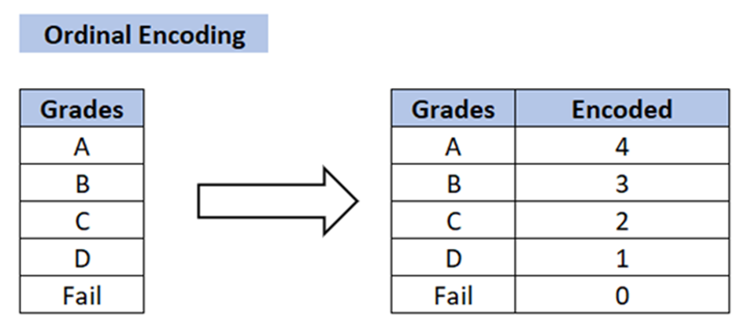
Encoding converts categorical or text-based data into a numerical format that models can understand and process, enabling them to learn patterns and make predictions. Without encoding, algorithms cannot interpret or use categorical data effectively. Encoding can be conversion of logical units in numeric value like converting all storage values into respective number or names into predefined number. Ordinal encoding converts categorical data into numerical values while preserving the natural order or ranking of the categories. It is imported from sklearn.preprocessing
Data Encoding
Richard Branson

Slide 16
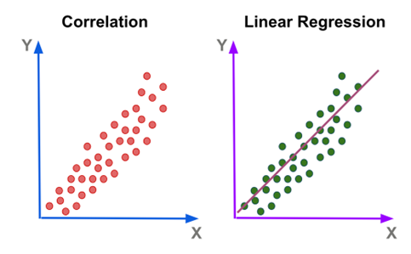
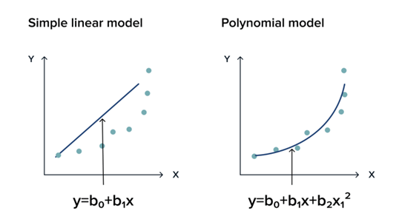
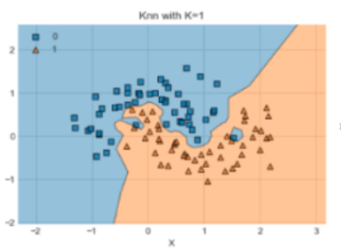
Machine learning methods used
Linear Regression: Linear regression models the relationship between independent and dependent variables by fitting a straight line (y = mx + b) to the data, minimizing the error between predicted and actual values.
Polynomial Regression: Polynomial regression extends linear regression by fitting a polynomial curve to the data, capturing non-linear relationships between the independent and dependent variables.
KNN Regression: K-Nearest Neighbors (KNN) regression predicts the target value by averaging the values of the k closest data points (neighbors) based on distance, making it a non-parametric and instance-based method

Slide 17
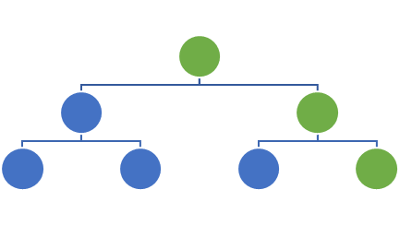
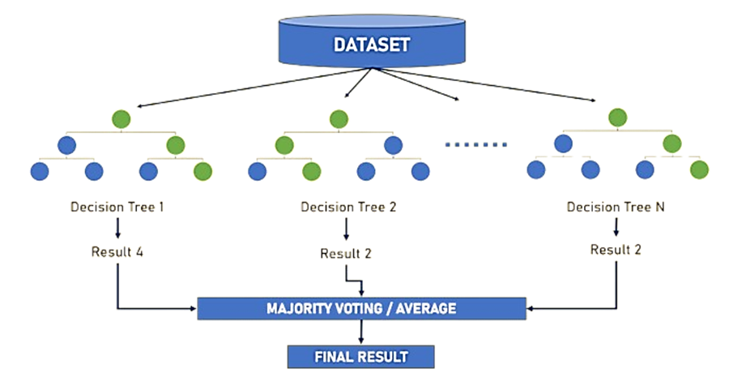
Machine learning methods used (contd.)
Single decision tree
Decision Tree: is a flowchart-like tree structure where an internal node represents a feature (or attribute), the branch represents a decision rule, and each leaf node represents the outcome.
Random Forest: is an ensemble learning method that constructs multiple decision trees during training and outputs the mode of the classification or mean prediction of the individual trees.
It improves predictive accuracy and control over-fitting by averaging multiple trees, which reduces variance

Slide 18
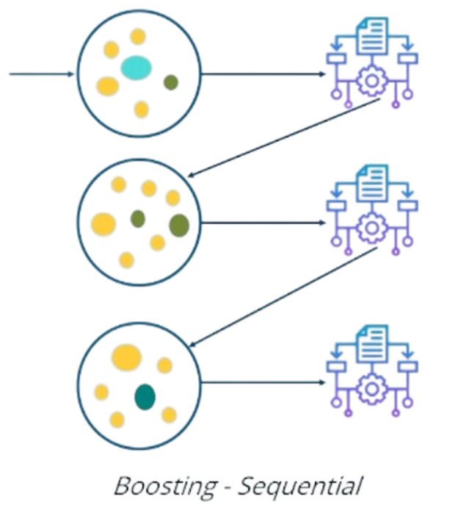

Boosting algorithm
Boosting algorithms are a family of ensemble methods that improve model performance by combining the predictions of several weak learners (typically decision trees) to create a stronger model. The key idea in boosting is to sequentially train weak learners, where each subsequent model focuses on correcting the errors made by the previous ones. Common boosting algorithms include:
1. AdaBoost: Adjusts the weights of incorrectly predicted samples so that the next learner focuses more on them.
2. Gradient Boosting: Optimizes a loss function by fitting new models to the residual errors of previous models.
3. XGBoost: A more efficient and scalable version of gradient boosting, designed for speed and performance in large datasets.
Boosting reduces bias and variance, leading to highly accurate models

Slide 19
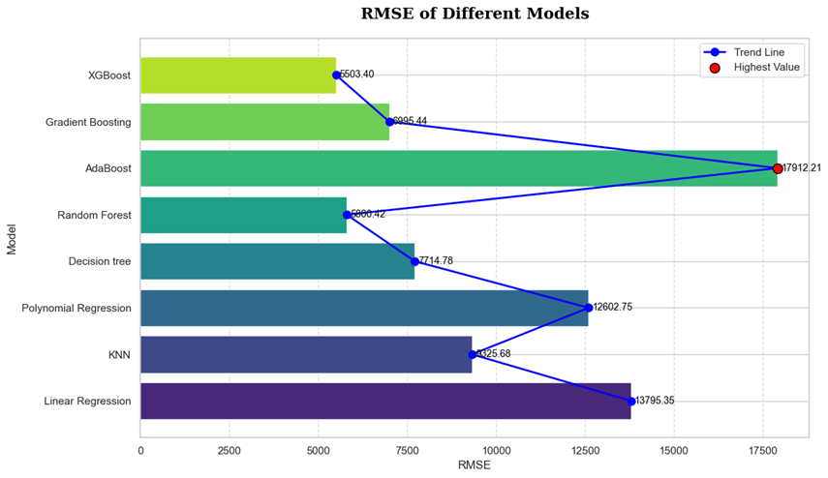
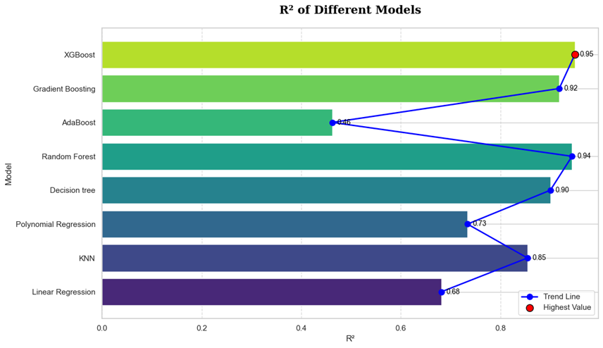
Comparison of each algorithm
We can see that the worst performing algorithm for our dataset was AdaBoost with a R² score of 0.46, and the best model was XGBoost with a very high score of 0.95.
These scores are specific to each dataset and does not state whether any algorithm is bad or good

Slide 20
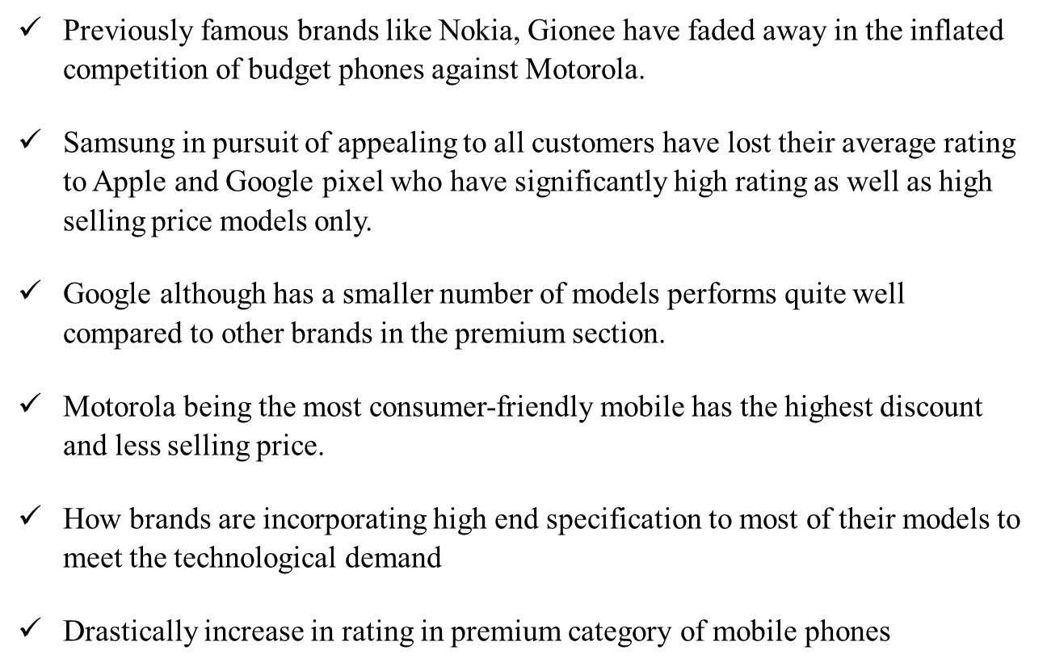
Conclusion

Slide 21




Thank you

